Slide 1
Capstone Week 5
Where and how to open a coffee shop around Moynahin Train Hall

Slide 2
Background:
Amtrak just opened a new train station in New York City across the street from Penn Station.
This train station, Moynahin Train Hall, will need to be surrounded by places for tourists to shop, just as Penn Station is.
Many tourists drink coffee so coffee shops will be needed.

Slide 3
Problem:
In order to know where and how to open this new coffee shop, we'll need to gather some information about the area.
We'll need to see where around this new train station there is an area without any places to buy coffee.
We'll also need to explore the existing local coffee places to see what is popular and unpopular among their visitors.

Slide 4
Interest:
Real estate developers deciding which type of building to build would be interested in this data.
Potential other parties interested in opening coffee shops would also be interested.
Additionally, tourists themselves would be interested just to figure out where they should go for coffee when they travel to and from this new train station.

Slide 5
Data:
Initially, the address of Moynahin Train Hall was obtained by using Google.com. The latitude and longitude of Moynahin Train Hall were then found using geopy and searching by the address. Foursquare was the main soured of data used to discover information about local coffee shops which currently exist. The foursquare data was converted using json. Pd.jason_normalize() was used to create a dataframe. This process was then repeated for multiple locations. Folium and Matplotlib were used to make a map with colors.

Slide 6
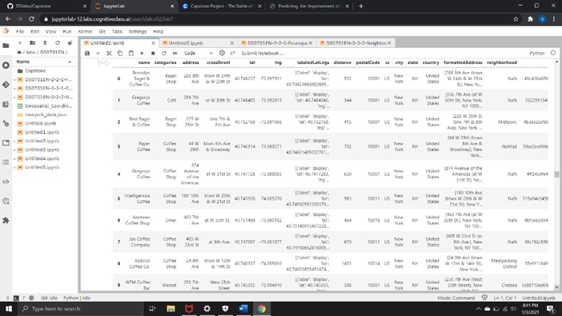
Current Coffee Shops in the Area:

Slide 7
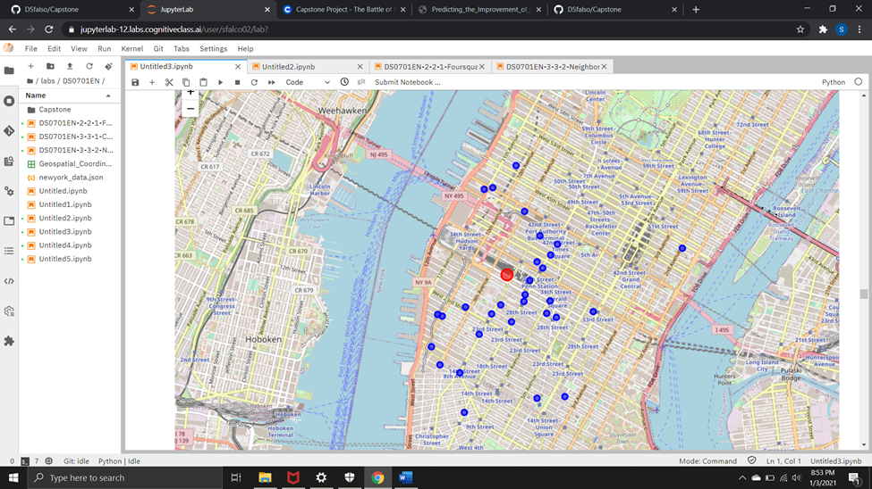
Current Coffee Shops in the Area:

Slide 8
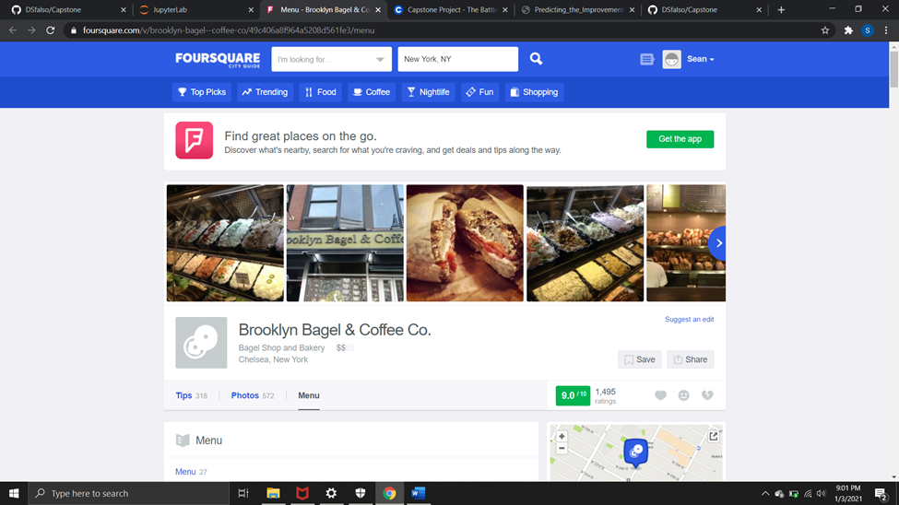
Popular Local Spot with Good Rating

Slide 9
Conclusion
We learned from the map that the best place to put our coffee shop is near the northwest area of Moynahin Train Hall, as there are currently no coffee places in the area. From the first restaurant we learned that consumers like to have bagels with their coffee and what kind of toppings are enjoyed. With the paid version, much more information could be found with a wordcloud. We learned that prices for coffee are generally low in the area. Perhaps, we could open a luxury style coffee shop with higher prices and better products to try to capture a different market than our local competition. On the second coffee shop, we saw that cold brew coffee was popular with the reviewer. We could consider adding cold brew coffee as it could be a local preference. We learned that local coffee shops are generally open around 7 am. Perhaps we could go earlier to capture an earlier crowd without competition.

